Slide 1

FocusEV
Conversion of a
Gasoline Powered Automobile to a
Battery Powered Electric Vehicle
Chris Simon

Slide 2

All of the energy that we use ultimately comes from the Sun. The electricity that powers the screen that you are viewing. The energy your body is using at this moment to read and think and breath. The energy that transported you to wherever you are right now.
Much of that energy was locked away in fossil fuels (petroleum, or coal) long ago.

Slide 3
Fossil Fuel Timeline
Millions of Years
Millions of Years
<200 years
Time
Oil formation took millions of years
The human race will completely consume it in hundreds of years
The fossil-fuel dependent society is unsustainable
The cost of fuel will increase dramatically as we get nearer to the end of the supply.

Slide 4
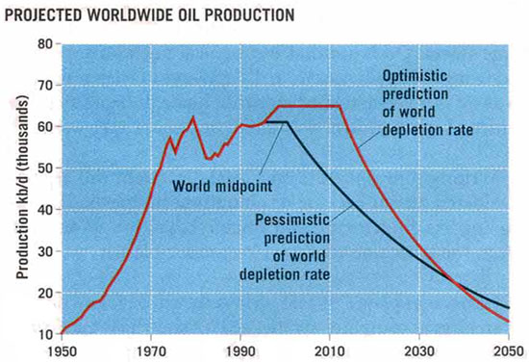
Fossil Fuel Timeline
(Need to find a chart from a known reputable source)

Slide 5

Considerations for an EV Conversion
What “donor car”?
How many batteries?
What type of motor?
What type of battery charger?
What type of batteries?
How do I keep warm?
What electronic controller should I use?
What high voltage contactor is available?
What special instrumentation do I need?
Before answering these you really need to ask:
  What are my goals for an electric vehicle?

Slide 6
Considerations for an EV Conversion
Here are the goals that I wrote down for an Electric Vehicle:
(in somewhat priority order)
Range that allows for my daily commute (Greater than 35 miles at 40 MPH, even in winter)
Use of an American donor car
A donor car with a manual transmission
Maximize the life of the batteries, which is the largest ongoing expense with an EV.
Ease of use (A vehicle that anyone can drive, with self-management of battery charging)
All components extendable to higher range and performance when better batteries become available)
Parts that are "Made in USA" where possible (Easier to deal with the suppliers if there's a problem.)
A design that prioritizes higher range over faster acceleration.
Quiet operation
Keep the weight down – stay close to the GVWR (Gross Vehicle Weight Rating)
Top speed of at least 65 MPH
Minimize initial cost of battery pack
Total conversion project cost less than $10,000 (not counting donor car)
Include heater and defroster for comfort through the Minnesota winter.
Flexible battery layout (not size specific) to allow an upgrade at a later date.
Suspension modified to compensate for additional weight of the batteries.
Brakes must operate as before conversion using a vacuum pump.

Slide 7
My Choices
Donor car - 2001 Ford Focus SE
  American made - Car and Driver’s “10 Best” multiple years
  Lightweight for efficiency, but reasonably high GVWR (to carry the weight of the batteries)
Motor - 9 inch diameter series-wound brushed DC motor (143 lbs.)
  Low cost ($1550) - Widely used in on-the-road EVs - High reliability
Batteries - 17 series 8V wet cell lead acid batteries (Golf cart)
  Wet cell Golf Cart batteries have long life for deep cycles (compared AGM or Gel batteries)
  Higher voltage (8V vs. 6V batteries) means higher top speed
  Low cost ($1800) because I was told “Everyone murders their first pack”
  The downside is WEIGHT (1,080 lbs of lead!)
Controller - Curtis 144V PWM controller with heatsink and fans
  Low cost ($1400) - High reliability (if properly cooled)
Electric Power Brake Vacuum Pump - MES-DEA 70/6E (with integral vacuum switch)
  Quiet (Relatively)
  Designed specifically for use in EVs
Electric Power Steering Pump – TBD
Instrumentation – Voltmeter (180 VDC) and Ammeter (500 ADC)
  Planning to add a uprocessor battery monitor system with dashboard-mounted display (VFD)
DC/DC Converter
  IOTA - 55 Ampere power supply – modified with inrush current limiter and power-on relay

Slide 8
Removal and Installation
Removed
Installed
Internal Combustion Engine (ICE)
Alternator
Gas tank
Fuel pump
Fuel filler tube
Power steering pump
Power steering hoses and cooler
Exhaust pipe and muffler
Catalytic converter
Radiator
Coolant hoses and reservoir
Air conditioning compressor
Air conditioning condenser
Liquid heater core
Floor of the trunk
Rear springs
Dashboard “idiot lights”
Electric motor with adapter
4 battery racks
Insulation in 4 battery racks
Heaters in 4 battery racks
17 batteries
High-power cables
High-power circuit breaker
Motor Controller
PotBox (connected to accelerator)
High-Voltage contactors
Control relays
Vacuum Pump
DC/DC converter
Electric heater element
Heavy duty rear springs
Ammeter and Voltmeter
Lots of wiring

Slide 9
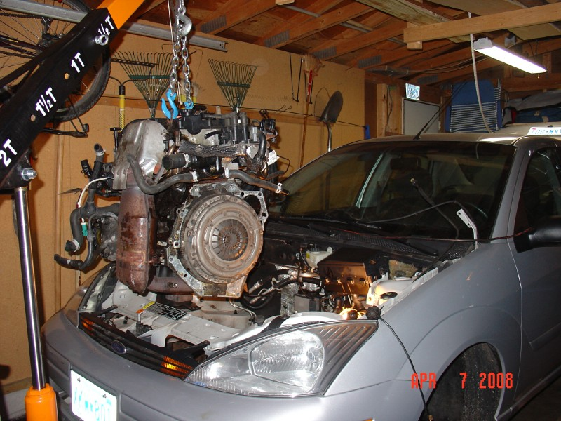
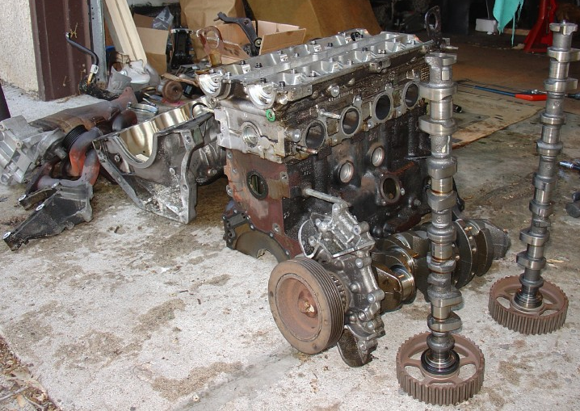
The Internal Combustion Engine (ICE) Comes Out

Slide 10
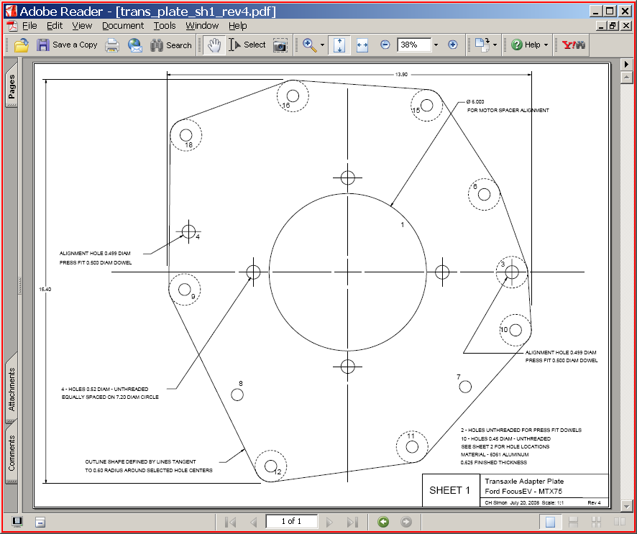
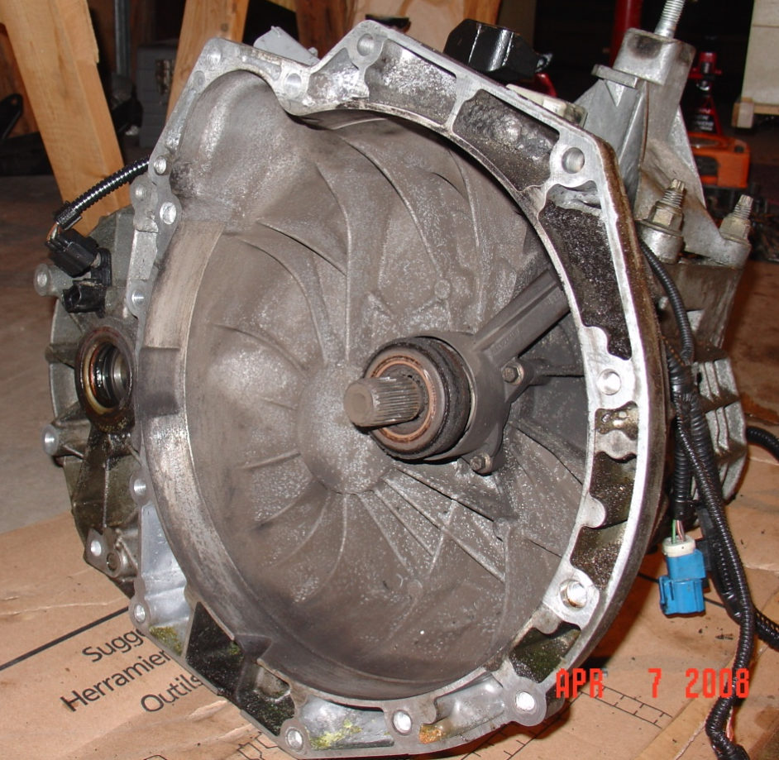
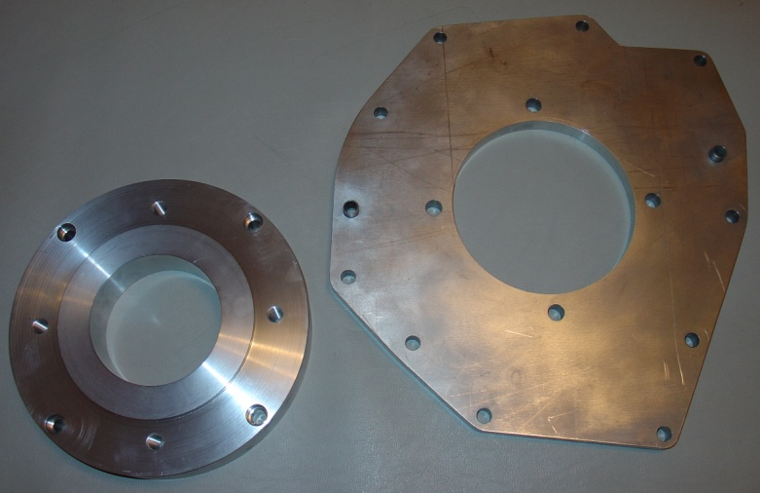
Adapter Design
Mating face of the transaxle

Slide 11
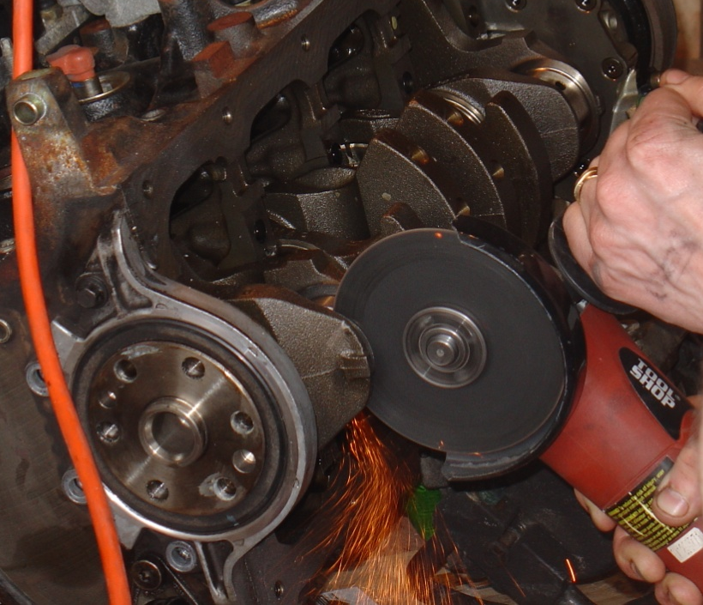
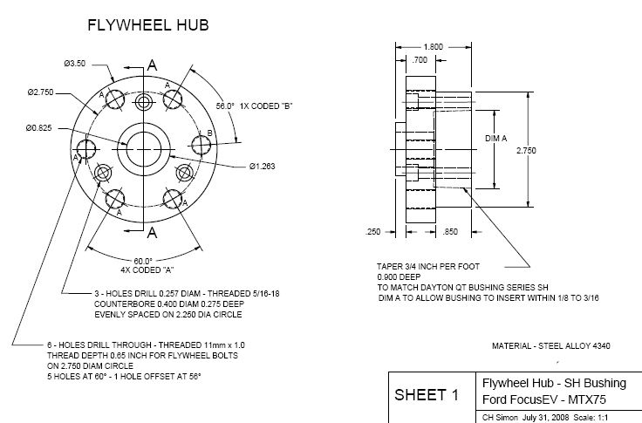
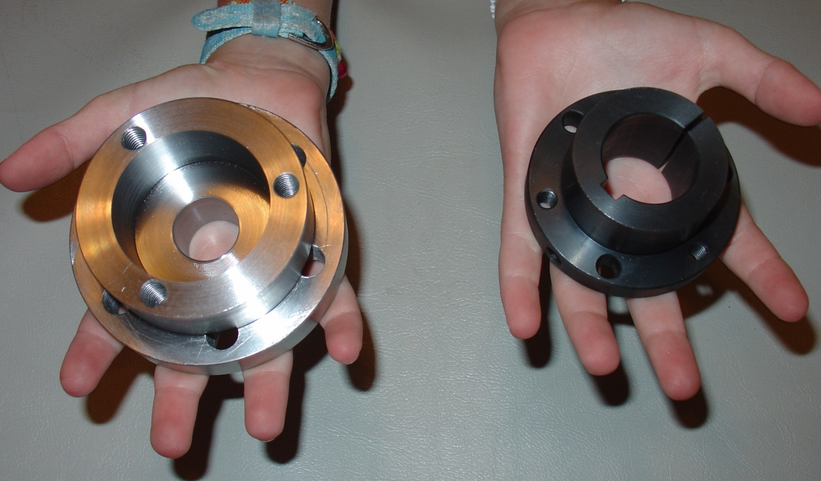
Flywheel Hub Design

Slide 12
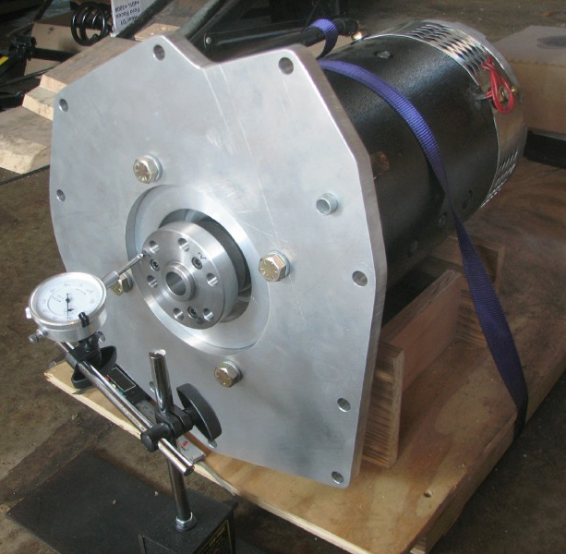
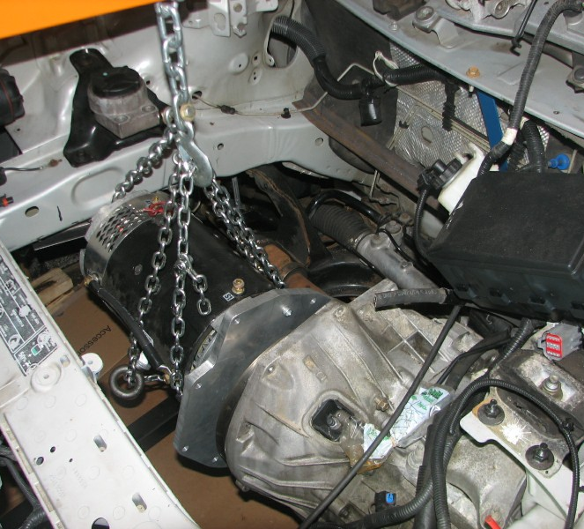
The Electric Motor Goes In
Aligning the motor to the already installed transaxle
Dial Indicator to check flywheel hub alignment and runout

Slide 13
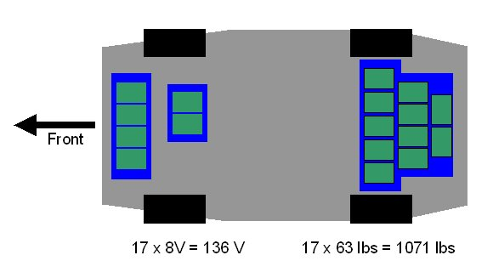
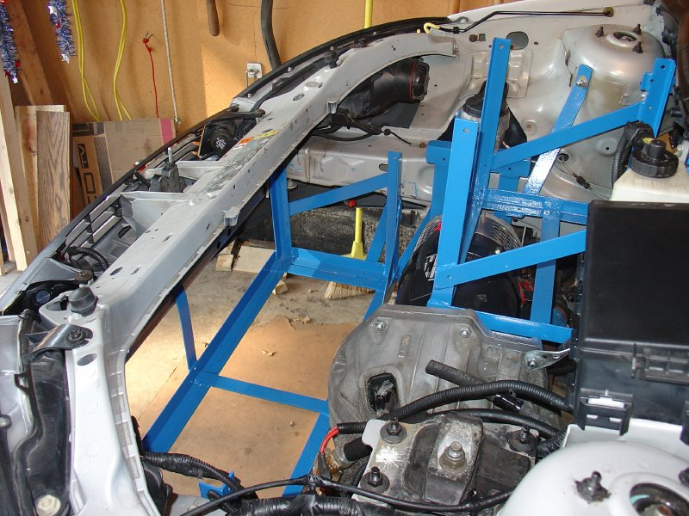
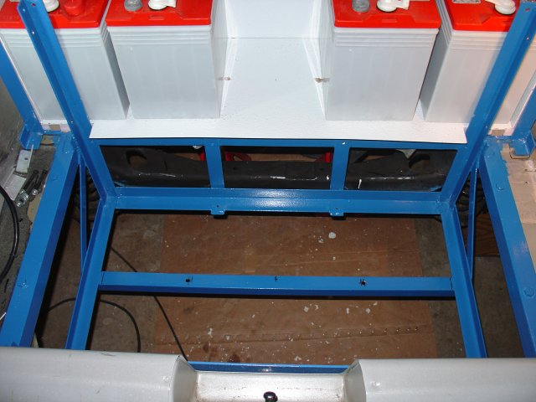
Battery Layout
What are the guidelines for adding 1,080 lbs of lead batteries?
  Keep them out of the passenger compartment
    They are filled with acid and vent hydrogen at the end of charging
  Keep them low and near the center of the car
    Low center of gravity for better handling
My car is a compromise based on where they’ll fit and the structure that can support the weight
Front and mid battery racks
Rear battery rack

Slide 14
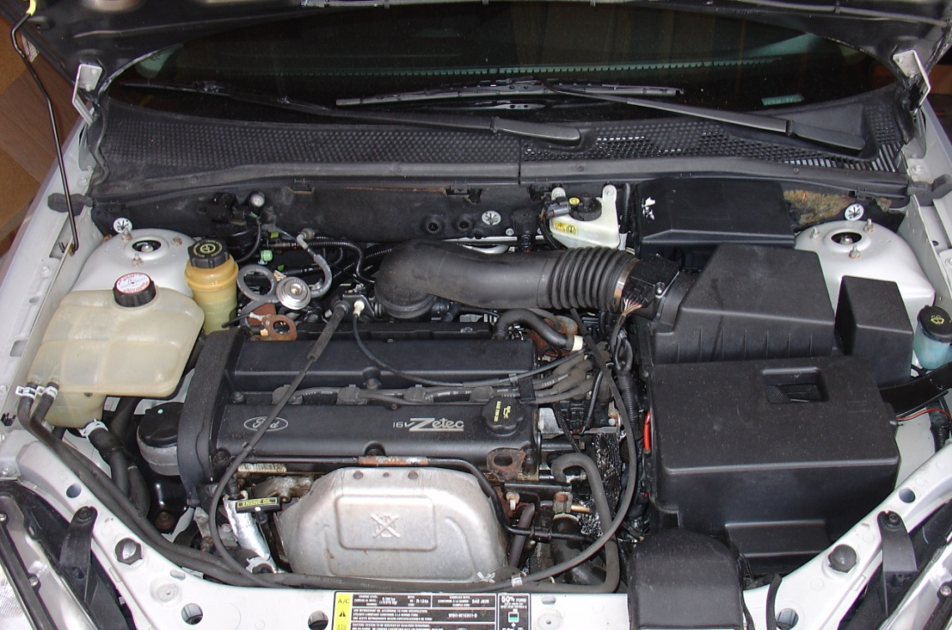
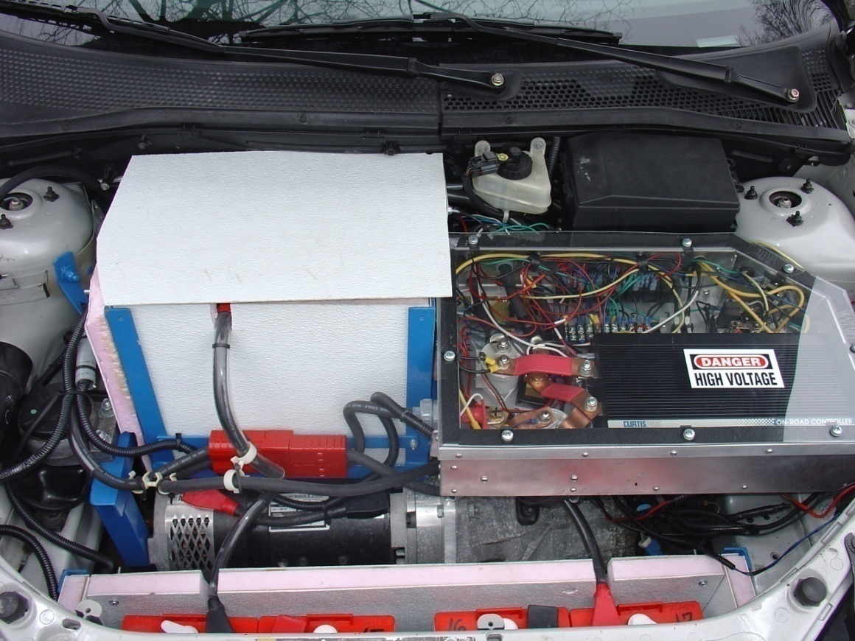
Before and After
Contactors and relays
Electronic Controller
Batteries
Electric Motor

Slide 15
Battery Connections
Batteries are connected in series with 00 gauge stranded copper cable
Use automotive style lead battery posts with copper terminals for low resistance connections
Keep the wiring short for lower resistive losses (and lower cost!)
Minimize the loop area of the current (up to 500A pulse width modulated at 15 KHz)
Circuit breaker in the middle of the pack – emergency shut-off accessible by the driver
Charger 1 (72V)
Batteries 1- 9
USB 8V
7
USB 8V
8
USB 8V
14
6
USB 8V
USB 8V
5
13
USB 8V
USB 8V
USB 8V
15
CB
9
USB 8V
USB 8V
12
11
USB 8V
Control Box
USB 8V
16
10
USB 8V
USB 8V
4
1
USB 8V
USB 8V
17
3
USB 8V
2
Charger 2 (64V)
Batteries 10- 17

Slide 16
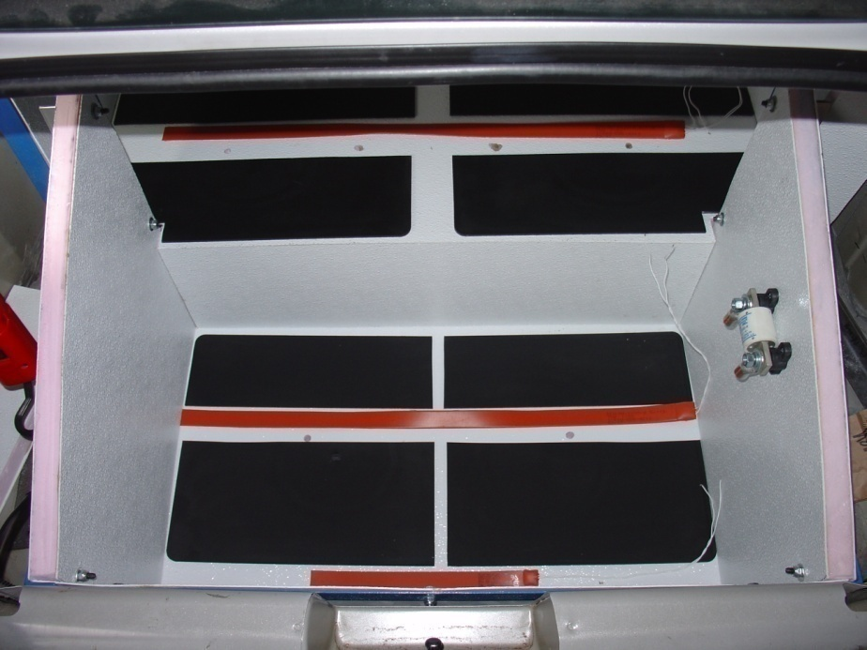
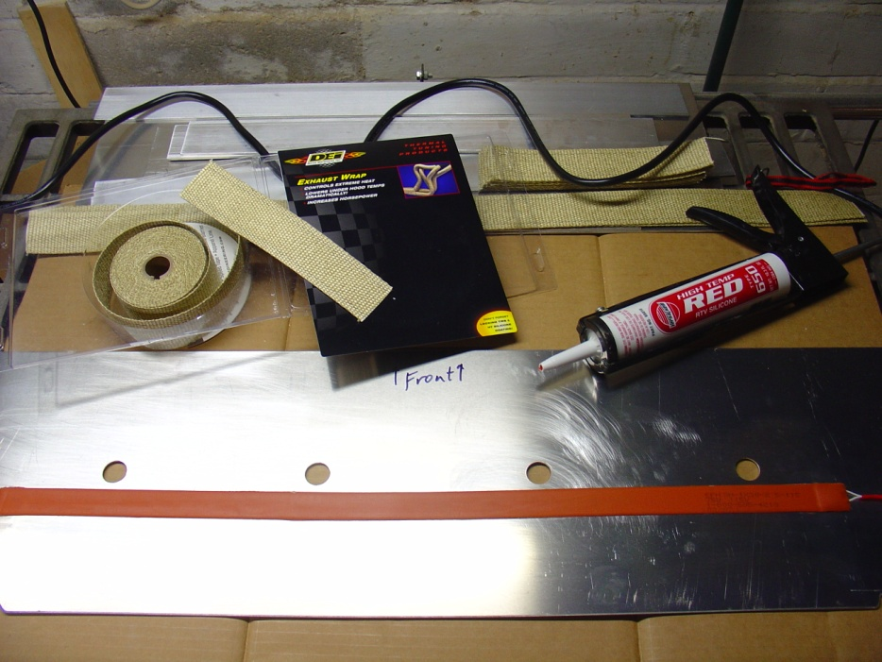
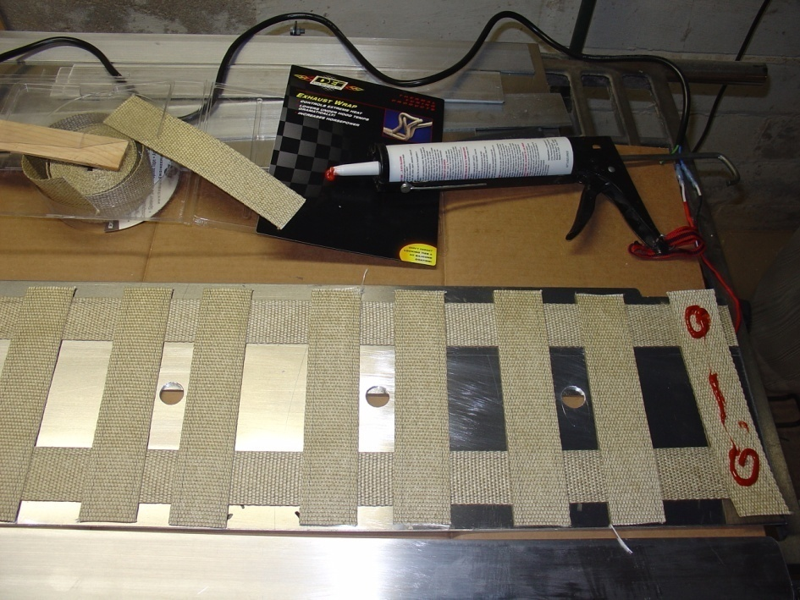
Battery Heaters
While charging 110 VAC heating elements are plugged in. There are thermostats for each set of batteries. It took me three tries to get it right.
Attempt 1 – Bad smells and discolored fiberglass
Attempt 2 – Another EV converter burned up his heater strips and melted through his batteries
Attempt 3 – Success! Gently warming the batteries using an aluminum heat-spreader

Slide 17
Wiring (Simplified)
100
50W
VBB = 136 VDC Nominal
SECONDARY
Front BBox
14-17
BusBar
S
BusBar
T10
1231C Controller
Mid BBox
12-13
B-
B+
M-
BusBar
CUTOFF CB
Rear BBox
1-11
MAIN
M
BusBar
S1
A1
T10
S2
A2
Motor
M-
B+
PWM
Ctrl
Accel
Pedal
PotBox
From PotBox
NC
NO
B-

Slide 18
“Pedal Hot” LED
Pre-Charge Detect (TBD)
Circuit Board
A
V
To Heater Switch Relay
LATCH
T10
100
50W
F4
T10
SECONDARY
Front BBox
14-17
BusBar
S
BusBar
B
Shunt
T10
T8
1231C Controller
F5
F6
F9
F10
F1
22 uF
Mid BBox
12-13
T1
HEATER
B-
B+
F3
M-
A2
T4
T2
T10
BusBar
DC/DC
Heater
F7
CUTOFF CB
F2
M
Shunt
Rear BBox
1-11
F8
MAIN
M
BusBar
S1
A1
T10
ACCEL
T5
LATCH
S2
A2
Timer
Interior
Pre-Heater
12V RUN
5
22 uF
T10
GR/OG
INERTIA SW
AC POWER
BRAKES
CLUTCH
3.3K
Interlock
Relays
1
2
NEUTRAL
4
3
MTR OT
T7
REVERSE
From AC Relays
Open (Gnd = AC Present)
T10
6
8
From Brake Switch (C824-1)
12V (Open = Brake Depressed)
T10
From Neutral Switch (Not Available - left open)
Open (Gnd = In Neutral)
Accel
Pedal
PotBox
To OverTemp Light
Heater AC
Charger AC
From Clutch Switch (C825-3)
Gnd (Open = Clutch Pressed)
NC
NO
Timeline for normal operation
From Motor OverTemp
Gnd (Open = Overheated)
From Reverse Switch (C95-16)
Open (12V = Reverse)
Key ON Caps charged Pedal depressed Pedal released Brake depressed
MAIN on, Pre-charge, DC/DC on PH LED on KSI on, ACCEL Latch on, SECOND on ACCEL Latch off, KSI off, SECOND off

Slide 19
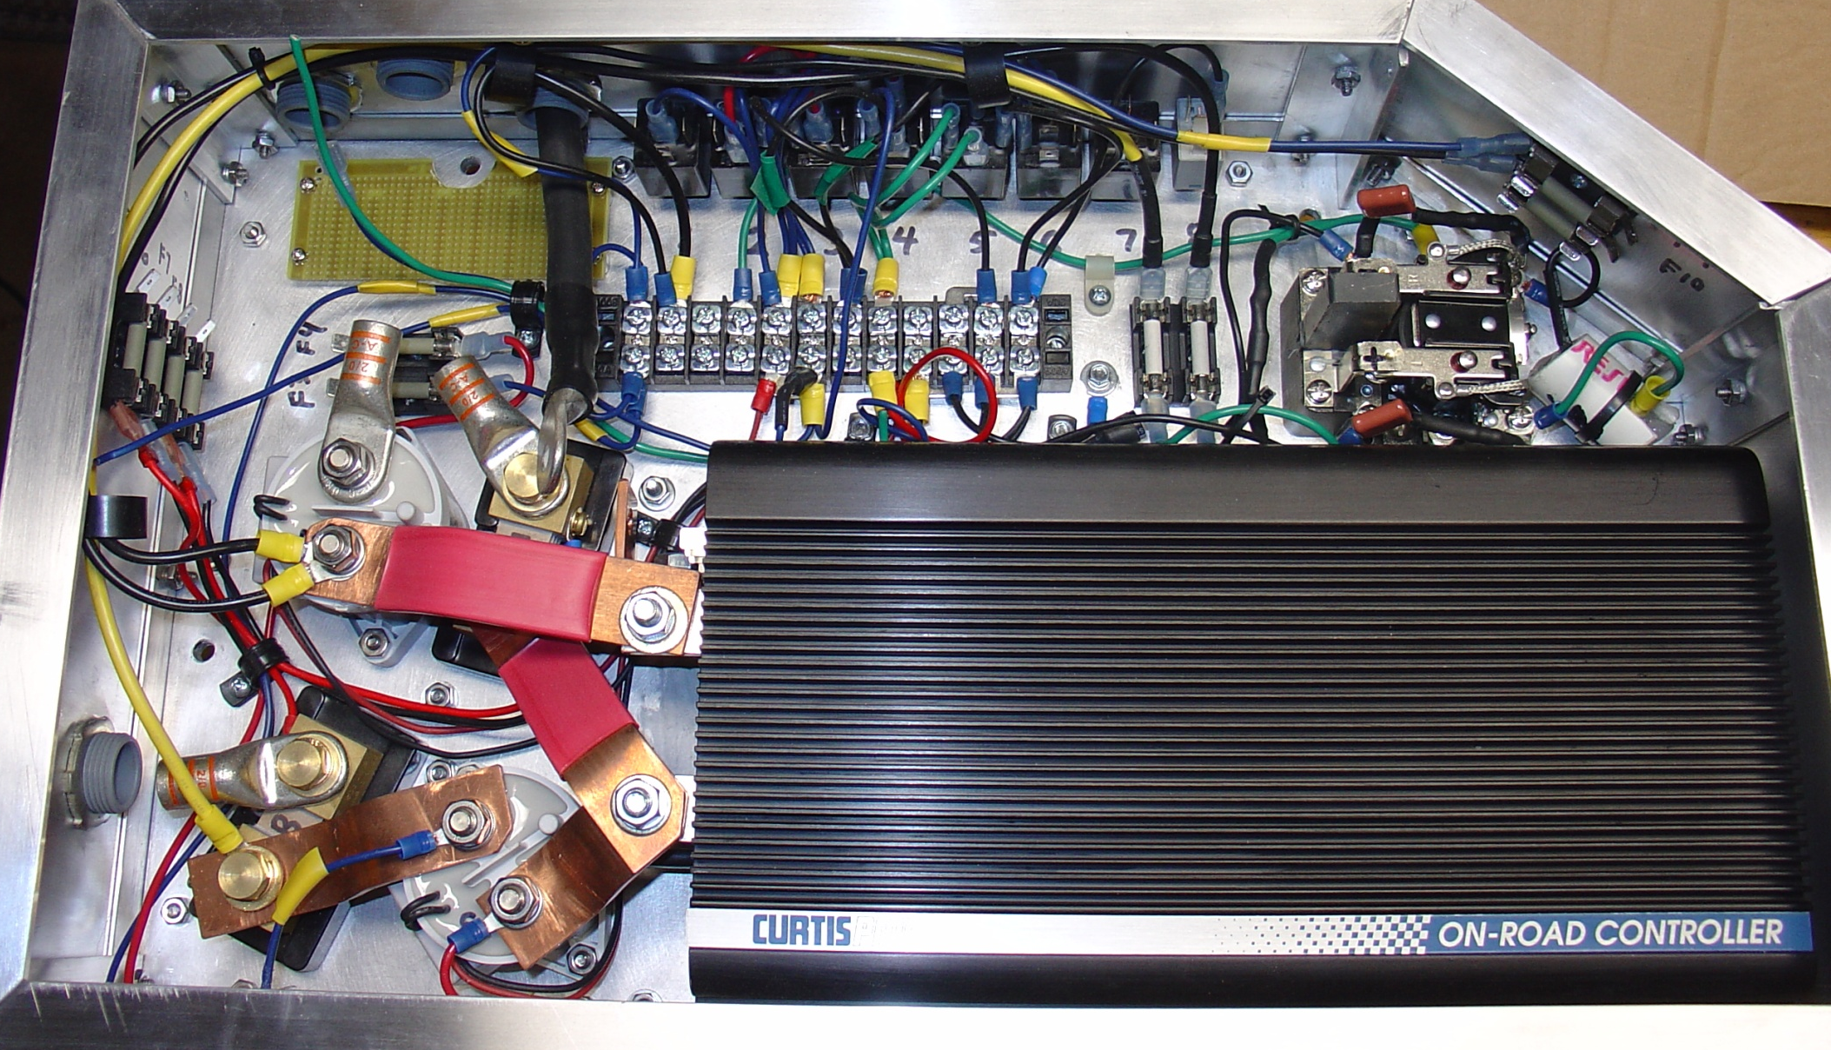
Wiring as Implemented

Slide 20
EV Control
MAIN contactor = Key on & Inertia Switch OK & No AC POWER
SECONDARY contactor = MAIN cont & No BRAKES & No CLUTCH & ACCEL Latch
AC POWER relay path will be closed when neither the chargers or the heaters are connected to AC power.
BRAKES relay path will be closed when the brake pedal is not depressed.
CLUTCH relay path will be closed when the clutch pedal is not depressed.
Purpose of ACCEL Latch relay: Prevent the SECONDARY contactor from opening and closing with the ACCEL pedal (when coasting, for example.) Instead it will close when the ACCEL pedal is first pressed and open when the BRAKES or CLUTCH are applied.
Bat Pack = 17 x 4 cells = 68 cells (136 VDC)
Depleted Bat Pack Voltage (0% SoC) = 68 x 1.91 V = 130 VDC
Minimum Bat Pack Voltage (40% SoC) = 68 x 1.99 V = 135 VDC
Maximum Bat Pack Voltage (100% SoC) = 68 x 2.12 V = 144 VDC

Slide 21
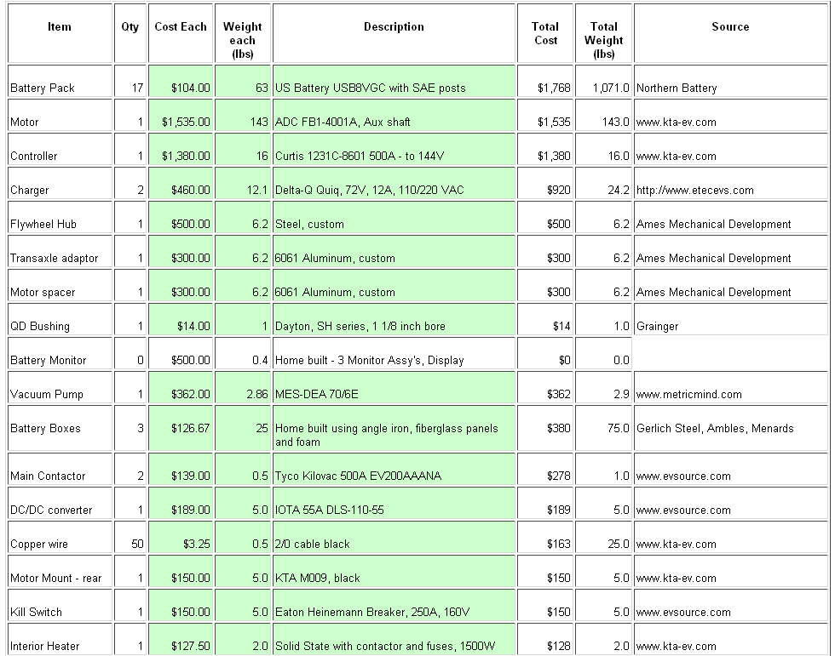
FocusEV Parts List (1 of 2)

Slide 22
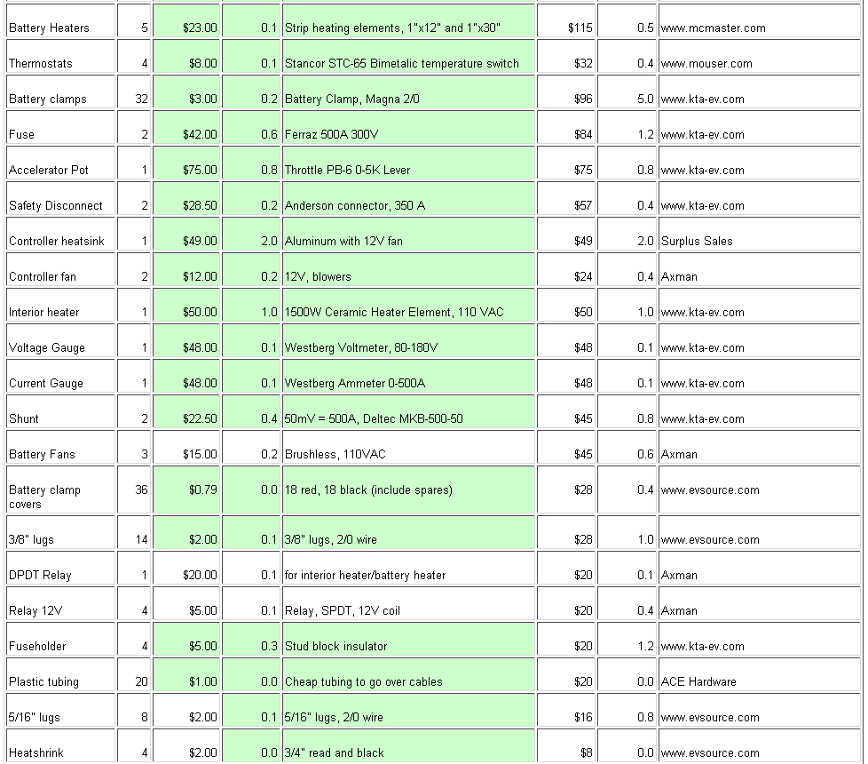
FocusEV Parts List (2 of 2)

Slide 23
Driving an EV
Lots of torque when starting from a stop (at the expense of large current draw from the batteries)
  Torque falls off as RPMs increase – the opposite of a modern small engine
The motor stops spinning when you release the accelerator pedal – no wasted energy in stop-and-go traffic
Range is affected very much by driving style, as compared to an ICE powered car
  Avoid prolonged time on freeways (air resistance is proportional to velocity²)
  Avoid quick starts
  Anticipate stoplights and traffic slowing to avoid braking
  Keep the motor RPMs in the most efficient range (~4000 RPM for a series-wound DC electric motor)
  These are all basic “hypermiling” techniques

Slide 24
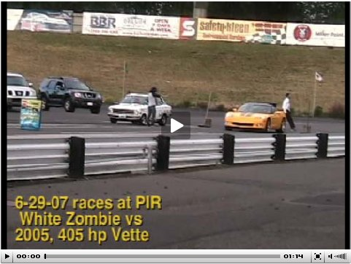
How Some People Drive an EV
Acceleration in an EV is less than with an ICE
  Unless your required range is ¼ mile http://www.plasmaboyracing.com/videos.php
Electric 1972 Datsun 1200 vs 2005 Corvette

Slide 25

FocusEV First Drive
http://www.youtube.com/watch?v=EcNZ5QoW7Yk

Slide 26
Cost for Energy
Internal Combustion Engine vs. Electric Vehicle
ICE Powered Car
FocusEV
1 gallon of gas has approximately 36 KW-Hr of energy
The energy that goes to moving a car down the road is about 20% (~80% is lost as heat)
For a car that gets 25 MPG and gasoline at $2.00 per gallon, fuel cost is
  $2.00/25 = $0.08 per mile
The FocusEV battery pack has approximately 23 KW-Hr of energy, with about 12.5 KW-Hr usable (before degrading batteries)
That’s ~1/3 of a gallon of gas!
The energy that goes to moving a car down the road is about 80% (~20% is lost as heat)
For a car that uses 400 Wh per mile and electricity at $0.10 per KW-Hr, fuel cost is
  0.4 x $0.10 = $0.04 per mile
400 Wh/mile is energy equivalent to ~90 MPG

Slide 27
Greenhouse Gasses
Internal Combustion Engine vs. Electric Vehicle
ICE Powered Car
FocusEV
19.5 lbs of CO2 for every gallon of gas consumed in an ICE
Assume 800 miles per month at 25 MPG (32 gallons)
CO2 released into the atmosphere:
    19.5 lbs/gallon x 32 gallons
    = 624 lbs CO2 per month
Additional CO2 is released in the extraction and refinement of crude oil
  CO2 per gallon is increasing as oil is recovered from undesirable sources such as oil sands
1.4 lbs*of CO2 for every kW-hr of electricity generated in the US
Assume 800 miles per month at 400 W-hr/mile (320 KW-Hr)
CO2 released into the atmosphere:
      1.4 lbs/kW-Hr x 320 kW-Hr
      = 448 lbs CO2 per month
This will improve as we generate more electricity from solar, wind, and geothermal sources.
* U.S. Environmental Protection Agency estimate, November, 2004

Slide 28
Considerations for an EV Conversion
Were the goals met?
Range that allows for my daily commute (Greater than 35 miles at 40 MPH, even in winter)
Use of an American donor car
A donor car with a manual transmission
Maximize the life of the batteries, which is the largest ongoing expense with an EV.
Ease of use (A vehicle that anyone can drive, with self-management of battery charging)
All components extendable to higher range and performance when better batteries become available)
Parts that are "Made in USA" where possible (Easier to deal with the suppliers if there's a problem.)
A design that prioritizes higher range over faster acceleration.
Quiet operation
Keep the weight down – stay close to the GVWR (Gross Vehicle Weight Rating)
Top speed of at least 65 MPH
Minimize initial cost of battery pack
Total conversion project cost less than $10,000 (not counting donor car)
Include heater and defroster for comfort through the Minnesota winter.
Flexible battery layout (not size specific) to allow an upgrade at a later date.
Suspension modified to compensate for additional weight of the batteries.
Brakes must operate as before conversion using a quiet vacuum pump.
1 -> 10
6
10
10
8
6->9
8
9
8
8
4
10
9
7
6
7
5 -> 9
9

Slide 29
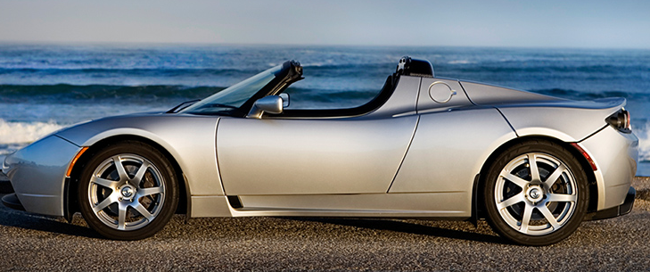
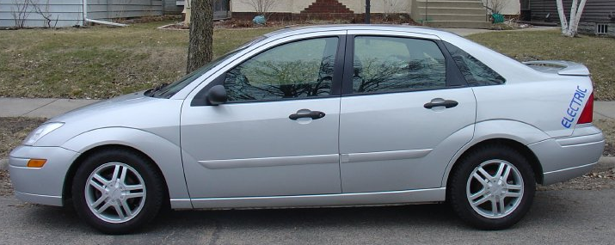
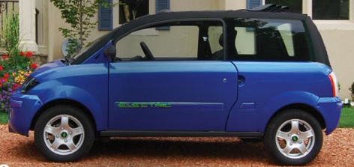
FocusEV vs. “the Competition”
Which car would you drive for your daily commute?
 | Tesla Roadster | Zenn NEV | FocusEV Home-built
Drive Motor | 185 KW AC Induction | 5.7 KW 3-phase AC | 50 KW Series Wound DC
Battery Pack | 53 KW-Hr Li-Ion 375V | 5 KW-Hr Lead-Acid 72V - Gel | 12.5 KW-Hr Lead-Acid 136V – Wet Cell
Top Speed | 125 MPH | 25 MPH | 70 MPH
Acceleration | 3.9 seconds (0 to 60) | Never (0 to 60) | ~22 seconds (0 to 60)
Range | 220 miles | 35 miles | 35 miles
Seats | 2 | 2 | 5
Tesla http://www.teslamotors.com/performance/tech_specs.php
Zenn http://www.zenncarsabq.com/pdf/zenn_2008specs.pdf

Slide 30
FocusEV vs. “the Competition”
Which car would you drive for your daily commute?
 | Tesla Roadster | Zenn NEV | FocusEV Home-built
Drive Motor | 185 KW AC Induction | 5.7 KW 3-phase AC | 50 KW Series Wound DC
Battery Pack | 53 KW-Hr Li-Ion 375V | 5 KW-Hr Lead-Acid 72V - Gel | 12.5 KW-Hr Lead-Acid 136V – Wet Cell
Top Speed | 125 MPH | 25 MPH | 70 MPH
Acceleration | 3.9 seconds (0 to 60) | Never (0 to 60) | ~22 seconds (0 to 60)
Range | 220 miles | 35 miles | 35 miles
Seats | 2 | 2 | 5
Cost | $109,000 | $15,995 | ~ $16,000
Hours of labor | None | None | You don’t want to know
Tesla http://www.teslamotors.com/performance/tech_specs.php
Zenn http://www.zenncarsabq.com/pdf/zenn_2008specs.pdf

Slide 31
Resources
The FocusEV Website (includes FAQs) http://www.simonfamily.us/FocusEV
The Electric Auto Association (with links to local chapters) http://www.eaaev.org
The EV Album – over 2,000 examples of vehicle conversions (skateboards, bikes, Porches, a Delorean, a Land Rover, etc.) http://www.evalbum.com/

